Slide 1

Lesson 9: Understanding the SEO Industry
Kubilay Cagatay
WEB 225

Slide 2
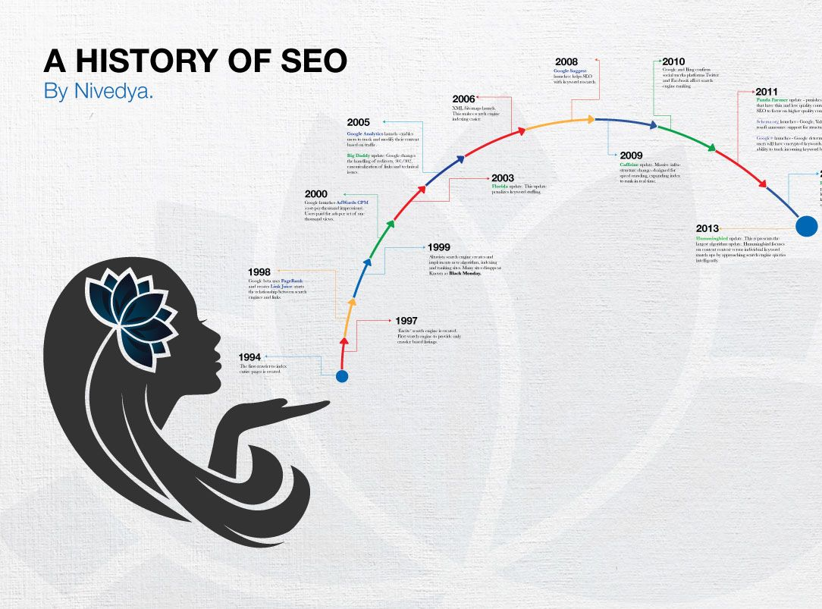
A Brief History of SEO
SEO has always been about influencing search engine results
But search engines have not always been like they are today
In the early 1990’s, some of the early search engines started appearing like Yahoo
At this time, early SEO used alphabetical and chronological order to get results to the top

Slide 3

A Brief History of SEO, continued
With time, search engines started using more sophisticated strategies and algorithms to determine top results
1997 – the term Search Engine Optimization
Search Engines began ranking pages using metrics and SEO became a business
In 2009, an estimated that more than 2 billion dollars would be spent on SEO services
Many Fortune 500 companies have full time SEO teams working to help their websites

Slide 4


Who Are Internet Marketers and Where Can I Find Them?
Internet Marketer = anyone who tries to drive traffic to a given website
There are 2 types of marketers: black hat and white hat
Black hat marketers are sneaky! They use tactics that go against search engine guidelines
White hat marketers work according to search engine guidelines. They work for the long term.

Slide 5

Don’t do business with these marketers
Anyone who claims:
They can guarantee top ratings
They will submit your site to a large amount of search engines (the only ones that really matter are Google and Bing)
They do mass directory submission

Slide 6
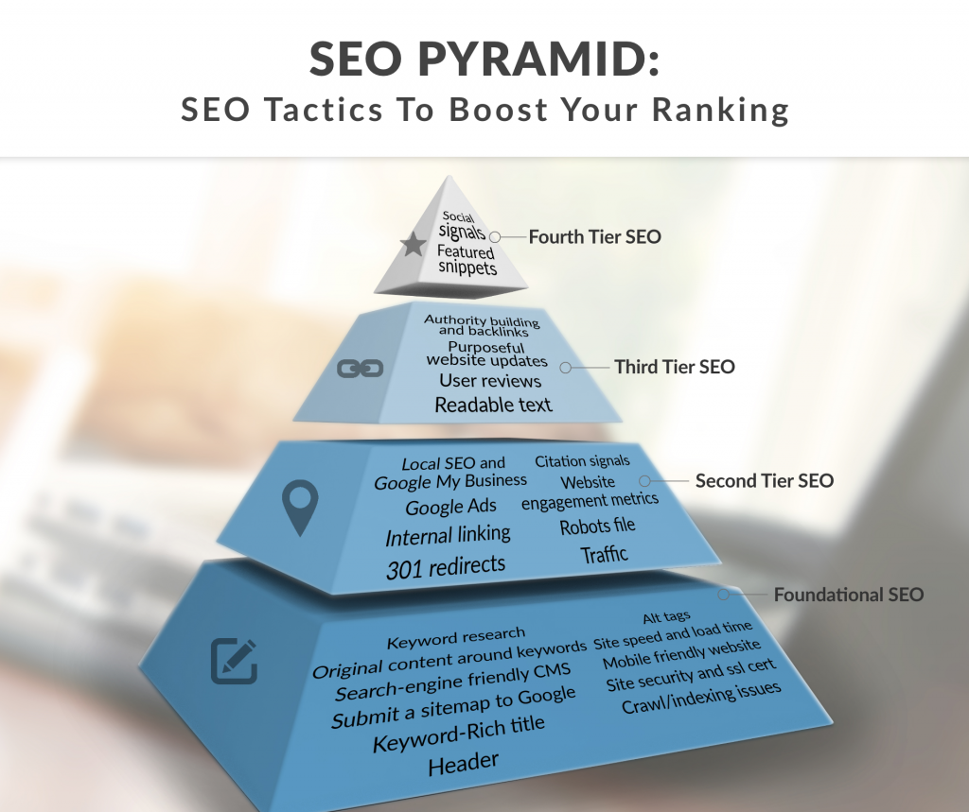
The SEO Pyramid and Wearing Multiple Hats
SEO consultants do many things including being a web developer, paid search marketer, or social media marketer.
These jobs all work together, and an SEO consultant should be strong in all areas

Slide 7

SEO Leaders
Some of the biggest names in the SEO industry:
Danny Sullivan – studied how search engines indexed web pages
Matt Cutts – head of Google’s Webspam team, enforces Google Webmaster Guidelines
Rand Fishkin – CEO and co-founder of SEOmoz, frequent speaker at conferences

Slide 8

The People and Technology behind Google
Culture – do their best to make employees as happy as possible
People – 20,000+ full-time employees, many are highly intelligent, accomplished and humble
Technology – operates one of the world’s largest global networks, invented its own operating and file system and is extremely efficient

Slide 9

The People and Technology behind Bing (Microsoft)
Culture – top-down management, and an excellent place to grow a career as they often promote from within
People – extremely intelligent and tech savvy, work closely with their departments
Technology – Windows products dominate the market, huge global systems

Slide 10


Long-Term Perspective in SEO
Goal will mainly always be to get good visitors to your site, however the strategies may change with time
Search engines will most likely be around for a very long time to come as people will always have information that they need to/want to look for

Slide 11


Thank you!

